Slide 1

计算机组成与系统结构 Computer Organization & System Architecture
Huang Kejie (黄科杰) 百人计划研究员
Office: 玉泉校区老生仪楼304
Email address: huangkejie@zju.edu.cn
HP: 17706443800

Slide 2
OpenMP
C extension: no new language to learn
Multi-threaded, shared-memory parallelism
Compiler Directives, #pragma
Runtime Library Routines, #include <omp.h>
#pragma
Ignored by compilers unaware of OpenMP
Same source for multiple architectures
E.g., same program for 1 & 16 cores
Only works with shared memory

Slide 3
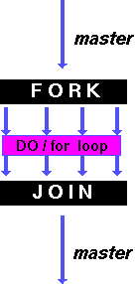
OpenMP Parallel for pragma
#pragma omp parallel for
for (i=0; i<max; i++) zero[i] = 0;
Master thread creates additional threads, each with a separate execution context
All variables declared outside for loop are shared by default, except for loop index which is implicitly private per thread
Implicit “barrier” synchronization at end of for loop
Divide index regions sequentially per thread
Thread 0 gets 0, 1, …, (max/n)-1;
Thread 1 gets max/n, max/n+1, …, 2*(max/n)-1
Why?

Slide 4
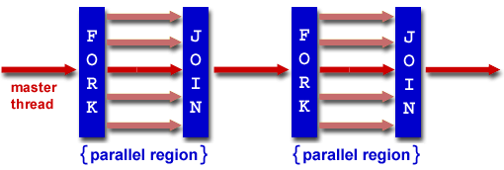
OpenMP Programming Model
Fork - Join Model:
OpenMP programs begin as single process (master thread)
Sequential execution
When parallel region is encountered
Master thread “forks” into team of parallel threads
Executed simultaneously
At end of parallel region, parallel threads ”join”, leaving only master thread
Process repeats for each parallel region
Amdahl’s Law?

Slide 5
What Kind of Threads?
OpenMP threads are operating system (software) threads
OS will multiplex requested OpenMP threads onto available hardware threads
Hopefully each gets a real hardware thread to run on, so no OS-level time-multiplexing
But other tasks on machine compete for hardware threads!

Slide 6
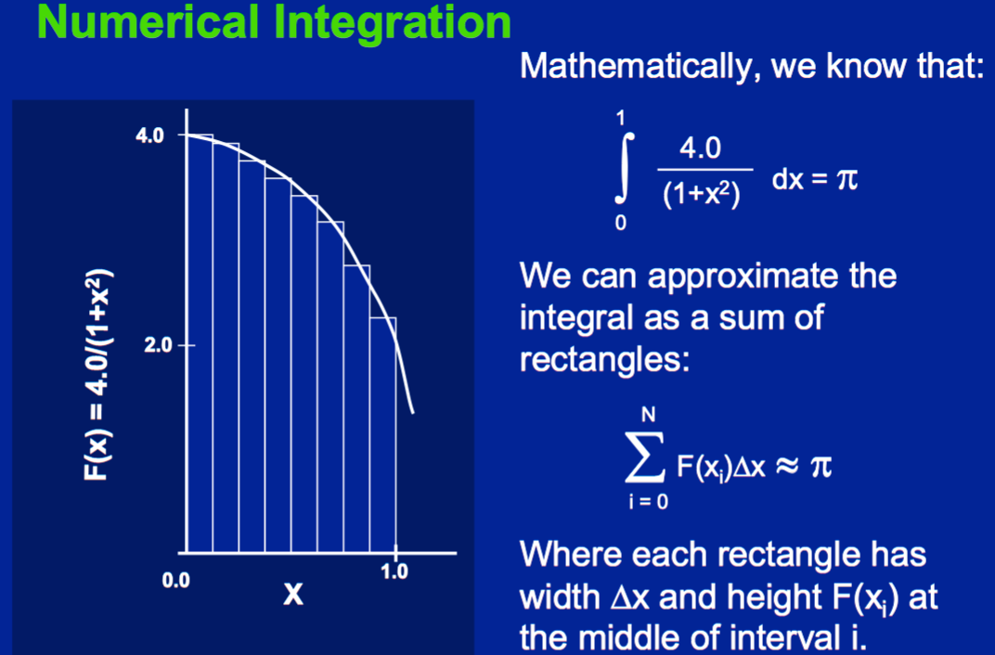
Example 2: Computing π
http://openmp.org/mp-documents/omp-hands-on-SC08.pdf

Slide 7
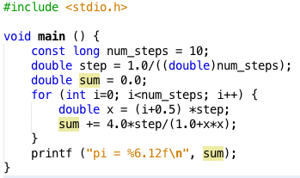
Sequential π
pi = 3.142425985001
Resembles π, but not very accurate
Let’s increase num_steps and parallelize

Slide 8
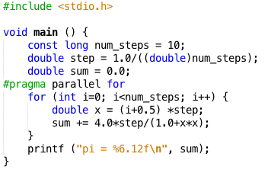
Parallelize (1) …
Problem: each threads needs access to the shared variable sum
Code runs sequentially …

Slide 9
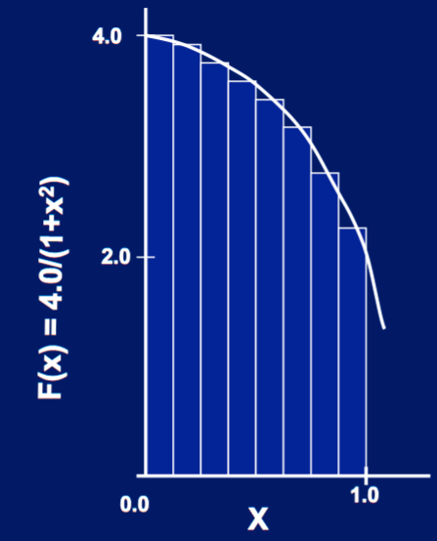
Parallelize (2) …
Compute
sum[0] and sum[1]
in parallel
Compute
sum = sum[0] + sum[1]
sequentially
sum[0]
sum[1]

Slide 10
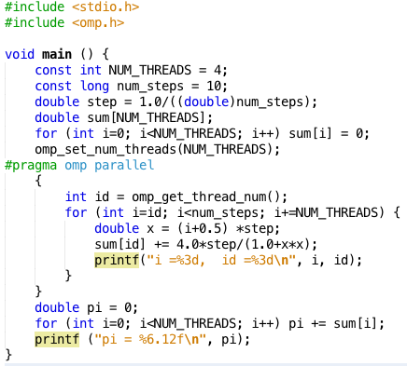
Parallel π
Trial Run
i = 1, id = 1
i = 0, id = 0
i = 2, id = 2
i = 3, id = 3
i = 5, id = 1
i = 4, id = 0
i = 6, id = 2
i = 7, id = 3
i = 9, id = 1
i = 8, id = 0
pi = 3.142425985001

Slide 11
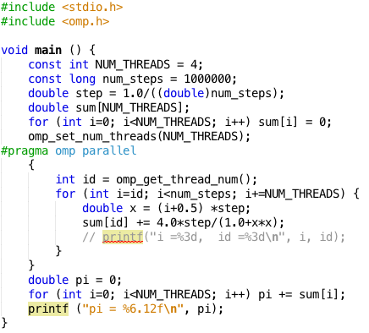
Parallel π
Scale up: num_steps = 10⁶
pi = 3.141592653590
You verify how many digits are correct …

Slide 12
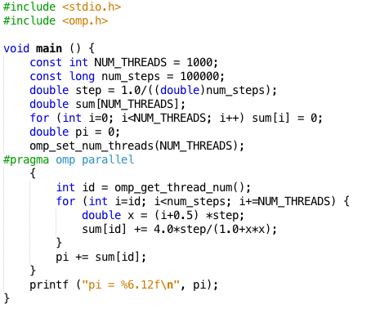
Can We Parallelize Computing sum?
Always looking for ways to beat Amdahl’s Law …
Summation inside parallel section
Insignificant speedup in this example, but …
pi = 3.138450662641
Wrong! And value changes between runs?!
What’s going on?

Slide 13
What Kind of Threads?
What are the possible values of *(x1) after executing this code by two concurrent threads?
# *(x1) = 100
lw x2,0(x1)
addi x2,x2,1
sw x2,0(x1)
Answer | *(x1)
RED | 100 or 101
GREEN | 101
ORANGE | 101 or 102
YELLOW | 100 or 101 or 102

Slide 14
What’s Going On?
Operation is really
pi = pi + sum[id]
What if >1 threads reads current (same) value of pi, computes the sum, stores the result back to pi?
Each processor reads same intermediate value of pi!
Result depends on who gets there when
A “race” → result is not deterministic

Slide 15
OpenMP Reduction
double avg, sum=0.0, A[MAX]; int i;
#pragma omp parallel for private ( sum )
for (i = 0; i <= MAX ; i++) sum += A[i];
avg = sum/MAX; // bug
Problem is that we really want sum over all threads!
Reduction: specifies that 1 or more variables that are private to each thread are subject of reduction operation at end of parallel region: reduction(operation:var) where
Operation: operator to perform on the variables (var) at the end of the parallel region
Var: One or more variables on which to perform scalar reduction.
double avg, sum=0.0, A[MAX]; int i;
#pragma omp for reduction(+ : sum)
for (i = 0; i <= MAX ; i++) sum += A[i];
avg = sum/MAX;

Slide 16
Calculating π Original Version
#include <omp.h>
#define NUM_THREADS 4
static long num_steps = 100000; double step;
void main () {
int i; double x, pi, sum[NUM_THREADS];
step = 1.0/(double) num_steps;
#pragma omp parallel private ( i, x )
{
int id = omp_get_thread_num();
for (i=id, sum[id]=0.0; i<num_steps; i=i+NUM_THREADS)
{
x = (i+0.5)*step;
sum[id] += 4.0/(1.0+x*x);
}
}
for(i=1; i<NUM_THREADS; i++)
sum[0] += sum[i]; pi = sum[0];
printf ("pi = %6.12f\n", pi);
}

Slide 17
Version 2: parallel for, reduction
#include <omp.h>
#include <stdio.h>
/static long num_steps = 100000;
double step;
void main ()
{ int i; double x, pi, sum = 0.0;
step = 1.0/(double) num_steps;
#pragma omp parallel for private(x) reduction(+:sum)
for (i=1; i<= num_steps; i++){
x = (i-0.5)*step;
sum = sum + 4.0/(1.0+x*x);
}
pi = sum;
printf ("pi = %6.8f\n", pi);
}

Slide 18
Synchronization
Problem:
Limit access to shared resource to 1 actor at a time
E.g. only 1 person permitted to edit a file at a time
otherwise changes by several people get all mixed up
Solution:
Take turns:
Only one person get’s the microphone & talks at a time
Also good practice for classrooms, btw …

Slide 19
Data Races and Synchronization
Two memory accesses form a data race if from different threads access same location, at least one is a write, and they occur one after another
If there is a data race, result of program varies depending on chance (which thread first?)
Avoid data races by synchronizing writing and reading to get deterministic behavior
Synchronization done by user-level routines that rely on hardware synchronization instructions

Slide 20
Locks
Computers use locks to control access to shared resources
Serves purpose of microphone in example
Also referred to as “semaphore”
Usually implemented with a variable
int lock;
0 for unlocked
1 for locked

Slide 21
Synchronization with Locks
// wait for lock released
while (lock != 0) ;
// lock == 0 now (unlocked)
// set lock
lock = 1;
// access shared resource ...
// e.g. pi
// sequential execution! (Amdahl ...)
// release lock
lock = 0;

Slide 22
Lock Synchronization
Thread 1
Thread 2
while (lock != 0) ;
lock = 1;
// critical section
lock = 0;
while (lock != 0) ;
lock = 1;
// critical section
lock = 0;
Thread 2 finds lock not set, before thread 1 sets it
Both threads believe they got and set the lock!
Try as you like, this problem has no solution, not even at the assembly level.
Unless we introduce new instructions, that is!

Slide 23
Hardware Synchronization
Solution:
Atomic read/write
Read & write in single instruction
No other access permitted between read and write
Note:
Must use shared memory (multiprocessing)
Common implementations:
Atomic swap of register ↔ memory
Pair of instructions for “linked” read and write
write fails if memory location has been “tampered” with after linked read
RISCV has variations of both, but for simplicity we will focus on the former

Slide 24
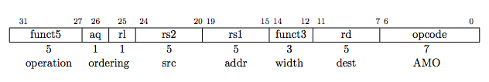
RISCV Atomic Memory Operations (AMOs)
AMOs atomically perform an operation on an operand in memory and set the destination register to the original memory value
R-Type Instruction Format: Add, And, Or, Swap, Xor, Max, Max Unsigned, Min, Min Unsigned
Load from address in rs1 to “t”
rd = ”t”, i.e., the value in memory
Store at address in rs1 the calculation “t” <operation> rs2
aq and rl insure in order execution
amoadd.w rd,rs2,(rs1):
t = M[x[rs1]];
x[rd] = t; M[x[rs1]] = t + x[rs2]

Slide 25
RISCV Critical Section
Assume that the lock is in memory location stored in register a0
The lock is “set” if it is 1; it is “free” if it is 0 (it’s initial value)
li t0, 1 # Get 1 to set lock
Try: amoswap.w.aq t1, t0, (a0) # t1 gets old lock value
# while we set it to 1
bnez t1, Try # if it was already 1, another
# thread has the lock,
# so we need to try again
… critical section goes here …
amoswap.w.rl x0, x0, (a0) # store 0 in lock to release

Slide 26
Lock Synchronization
Broken Synchronization
Fix (lock is at location (a0))
while (lock != 0) ;
lock = 1;
// critical section
lock = 0;
li t0, 1
Try amoswap.w.aq t1, t0, (a0)
bnez t1, Try
Locked:
# critical section
Unlock:
amoswap.w.rl x0, x0, (a0)

Slide 27
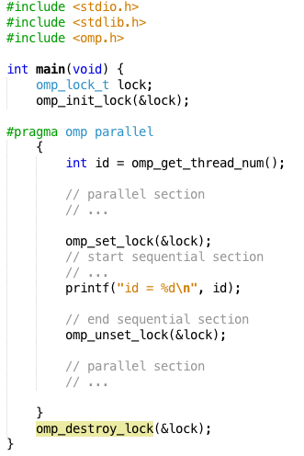
OpenMP Locks

Slide 28
Synchronization in OpenMP
Typically are used in libraries of higher level parallel programming constructs
E.g. OpenMP offers $pragmas for common cases:
critical
atomic
barrier
ordered
OpenMP offers many more features
See online documentation
Or tutorial at
http://openmp.org/mp-documents/omp-hands-on-SC08.pdf

Slide 29
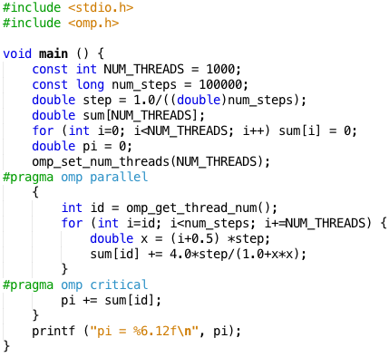
OpenMP Critical Section

Slide 30
The Trouble with Locks …
… is dead-locks
Consider 2 cooks sharing a kitchen
Each cooks a meal that requires salt and pepper (locks)
Cook 1 grabs salt
Cook 2 grabs pepper
Cook 1 notices s/he needs pepper
it’s not there, so s/he waits
Cook 2 realizes s/he needs salt
it’s not there, so s/he waits
A not so common cause of cook starvation
But deadlocks are possible in parallel programs
Very difficult to debug
malloc/free is easy …

Slide 31
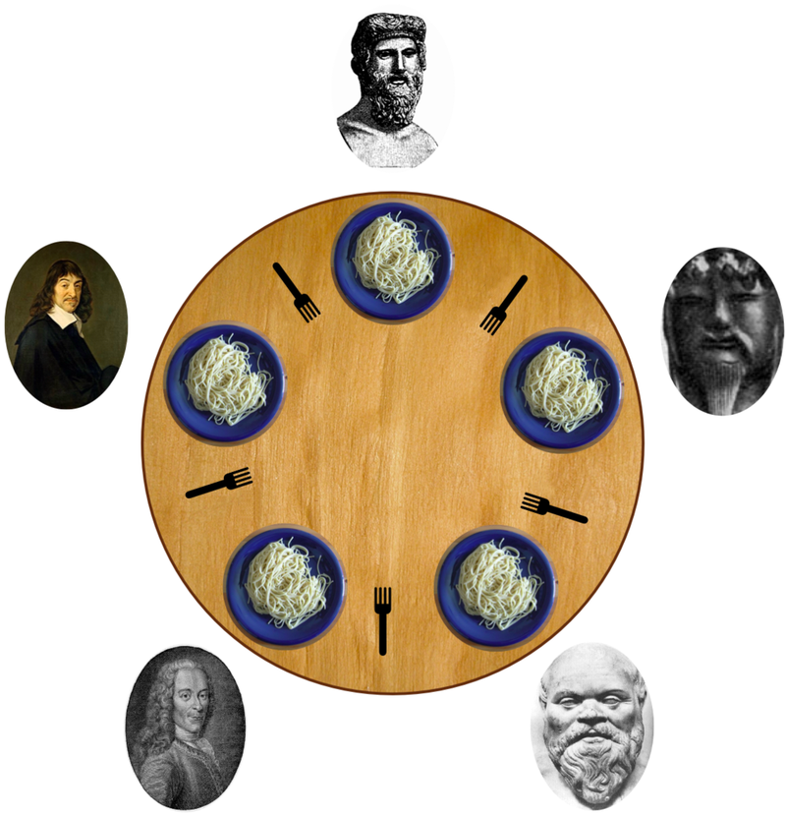
Deadlock
Deadlock: a system state in which no progress is possible
Dining Philosopher’s Problem:
Think until the left fork is available; when it is, pick it up
Think until the right fork is available; when it is, pick it up
When both forks are held, eat for a fixed amount of time
Then, put the right fork down
Then, put the left fork down
Repeat from the beginning
Solution?

Slide 32
OpenMP Timing
Elapsed wall clock time:
double omp_get_wtime(void);
Returns elapsed wall clock time in seconds
Time is measured per thread, no guarantee can be made that two distinct threads measure the same time
Time is measured from “some time in the past,” so subtract results of two calls to omp_get_wtime to get elapsed time

Slide 33
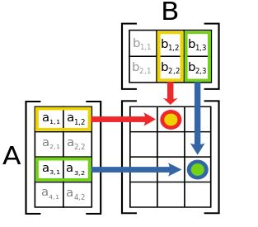
Matrix Multiply in OpenMP
// C[M][N] = A[M][P] × B[P][N]
start_time = omp_get_wtime();
#pragma omp parallel for private(tmp, j, k)
for (i=0; i<M; i++){
for (j=0; j<N; j++){
tmp = 0.0;
for (k=0; k<P; k++){
/* C(i,j) = sum(over k) A(i,k) * B(k,j)*/
tmp += A[i][k] * B[k][j];
}
C[i][j] = tmp;
}
}
run_time = omp_get_wtime() - start_time;
Outer loop spread across N threads; inner loops inside a single thread

Slide 34
Matrix Multiply in Open MP
More performance optimizations available:
Higher compiler optimization (-O2, -O3) to reduce number of instructions executed
Cache blocking to improve memory performance
Using SIMD AVX instructions to raise floating point computation rate (DLP)

Slide 35
And, in Conclusion, …
Sequential software execution speed is limited
Parallel processing is the only path to higher performance
SIMD: instruction level parallelism
Implemented in all high performance CPUs today (x86, ARM, …)
Partially supported by compilers
MIMD: thread level parallelism
Multicore processors
Supported by Operating Systems (OS)
Requires programmer intervention to exploit at single program level
E.g. OpenMP
SIMD & MIMD for maximum performance
Synchronization
Requires hardware support: specialized assembly instructions
Typically use higher-level support
Beware of deadlocks

Slide 36
Peer Instruction: Why Multicore?
The switch in ~ 2005 from one processor per chip to multiple processors per chip happened because:
The “power wall” meant that no longer get speed via higher clock rates and higher power per chip
There was no other performance option but replacing one inefficient processor with multiple efficient processors
OpenMP was a breakthrough in ~2000 that made parallel programming easy
RED I only
GREEN II only
ORANGE I & II only
YELLOW I, II, & III only

Slide 37
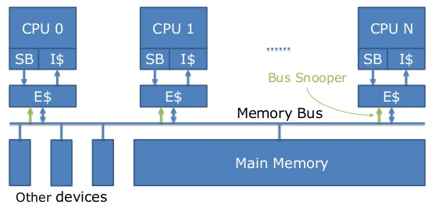
(Chip) Multicore Multiprocessor
SMP: (Shared Memory) Symmetric Multiprocessor
Two or more identical CPUs/Cores
Single shared coherent memory

Slide 38
Multiprocessor Key Questions
Q1 – How do they share data?
Q2 – How do they coordinate?
Q3 – How many processors can be supported?

Slide 39
Taxonomy of Parallel Computers
According to physical organization of processors and memory:
Physically centralized memory, uniform memory access (UMA)
All memory is allocated at same distance from all processors
Also called symmetric multiprocessors (SMP)
Memory bandwidth is fixed and must accommodate all processors → does not scale to large number of processors
Used in CMPs today (single-socket ones)
CPU
CPU
CPU
CPU
Cache
Cache
Cache
Cache
Interconnection
Main memory

Slide 40
Taxonomy of Parallel Computers
According to physical organization of processors and memory:
Physically distributed memory, non-uniform memory access (NUMA)
A portion of memory is allocated with each processor (node)
Accessing local memory is much faster than remote memory
If most accesses are to local memory than overall memory bandwidth increases linearly with the number of processors
Used in multi-socket CMPs E.g Intel Nehalem
CPU CPU CPU CPU
Node
Core 0
Nehalem-EP
Core 4
Nehalem-EP
Core 1
Core 2
Core 3
Core 5
Core 6
Core 7
Cache
Cache
Cache
Cache
L1
L1
L1
L1
L1
L1
L1
L1
L2
L2
L2
L2
L2
L2
L2
L2
Shared L3 Cache (inclusive)
Shared L3 Cache (inclusive)
IMC
QPI
QPI
IMC
Mem.
Mem.
Mem.
Mem.
DDR3 A
DDR3 B
DDR3 C
DDR3 D
DDR3 E
DDR3 F
I/O
I/O
Interconnection

Slide 41
Taxonomy of Parallel Computers
According to memory communication model
Shared address or shared memory
Processes in different processors can use the same virtual address space
Any processor can directly access memory in another processor node
Communication is done through shared memory variables
Explicit synchronization with locks and critical sections
Arguably easier to program??
Distributed address or message passing
Processes in different processors use different virtual address spaces
Each processor can only directly access memory in its own node
Communication is done through explicit messages
Synchronization is implicit in the messages
Arguably harder to program??
Some standard message passing libraries (e.g., MPI)

Slide 42
Shared Memory vs. Message Passing
Shared memory
Producer (p1)
flag = 0;
…
a = 10;
flag = 1;
Message passing
Producer (p1)
…
a = 10;
send(p2, a, label);
Consumer (p2)
flag = 0;
…
while (!flag) {}
x = a * y;
Consumer (p2)
…
receive(p1, b, label); x = b * y;

Slide 43
Shared Memory Multiprocessor (SMP)
Q1 – Single address space shared by all processors/cores
Q2 – Processors coordinate/communicate through shared variables in memory (via loads and stores)
Use of shared data must be coordinated via synchronization primitives (locks) that allow access to data to only one processor at a time
All multicore computers today are SMP

Slide 44
Multiprocessor Caches
Memory is a performance bottleneck even with one processor
Use caches to reduce bandwidth demands on main memory
Each core has a local private cache holding data it has accessed recently
Only cache misses have to access the shared common memory
Processor
Processor
Processor
Cache
Cache
Cache
Interconnection Network
Memory
I/O

